Slide 1
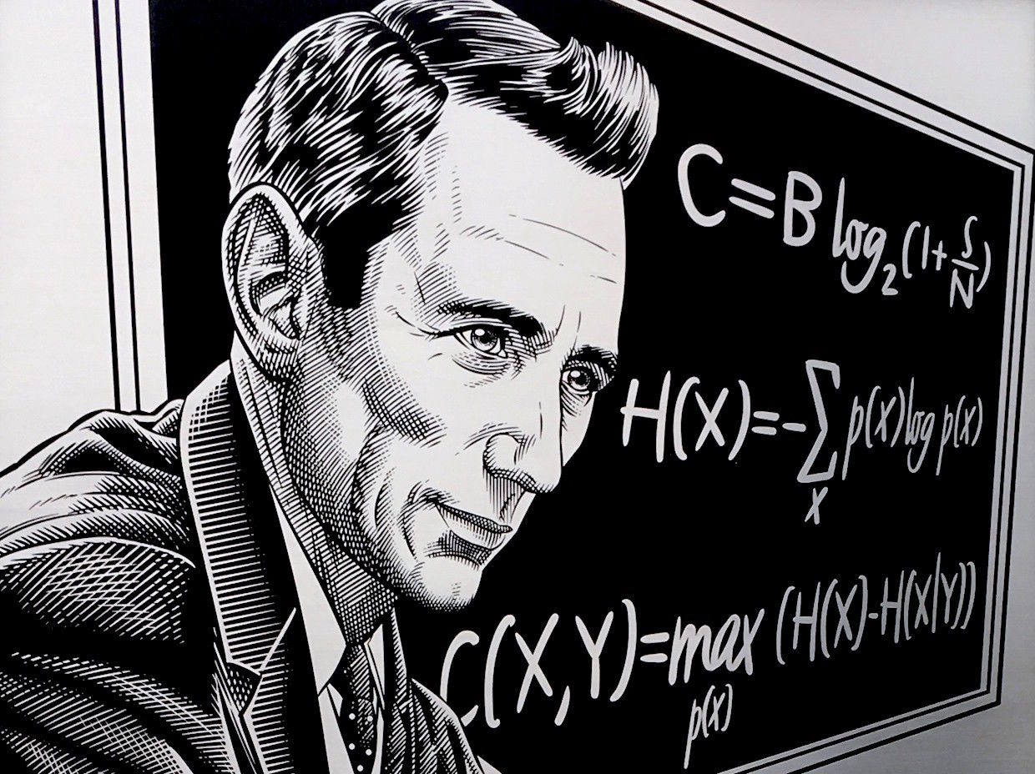
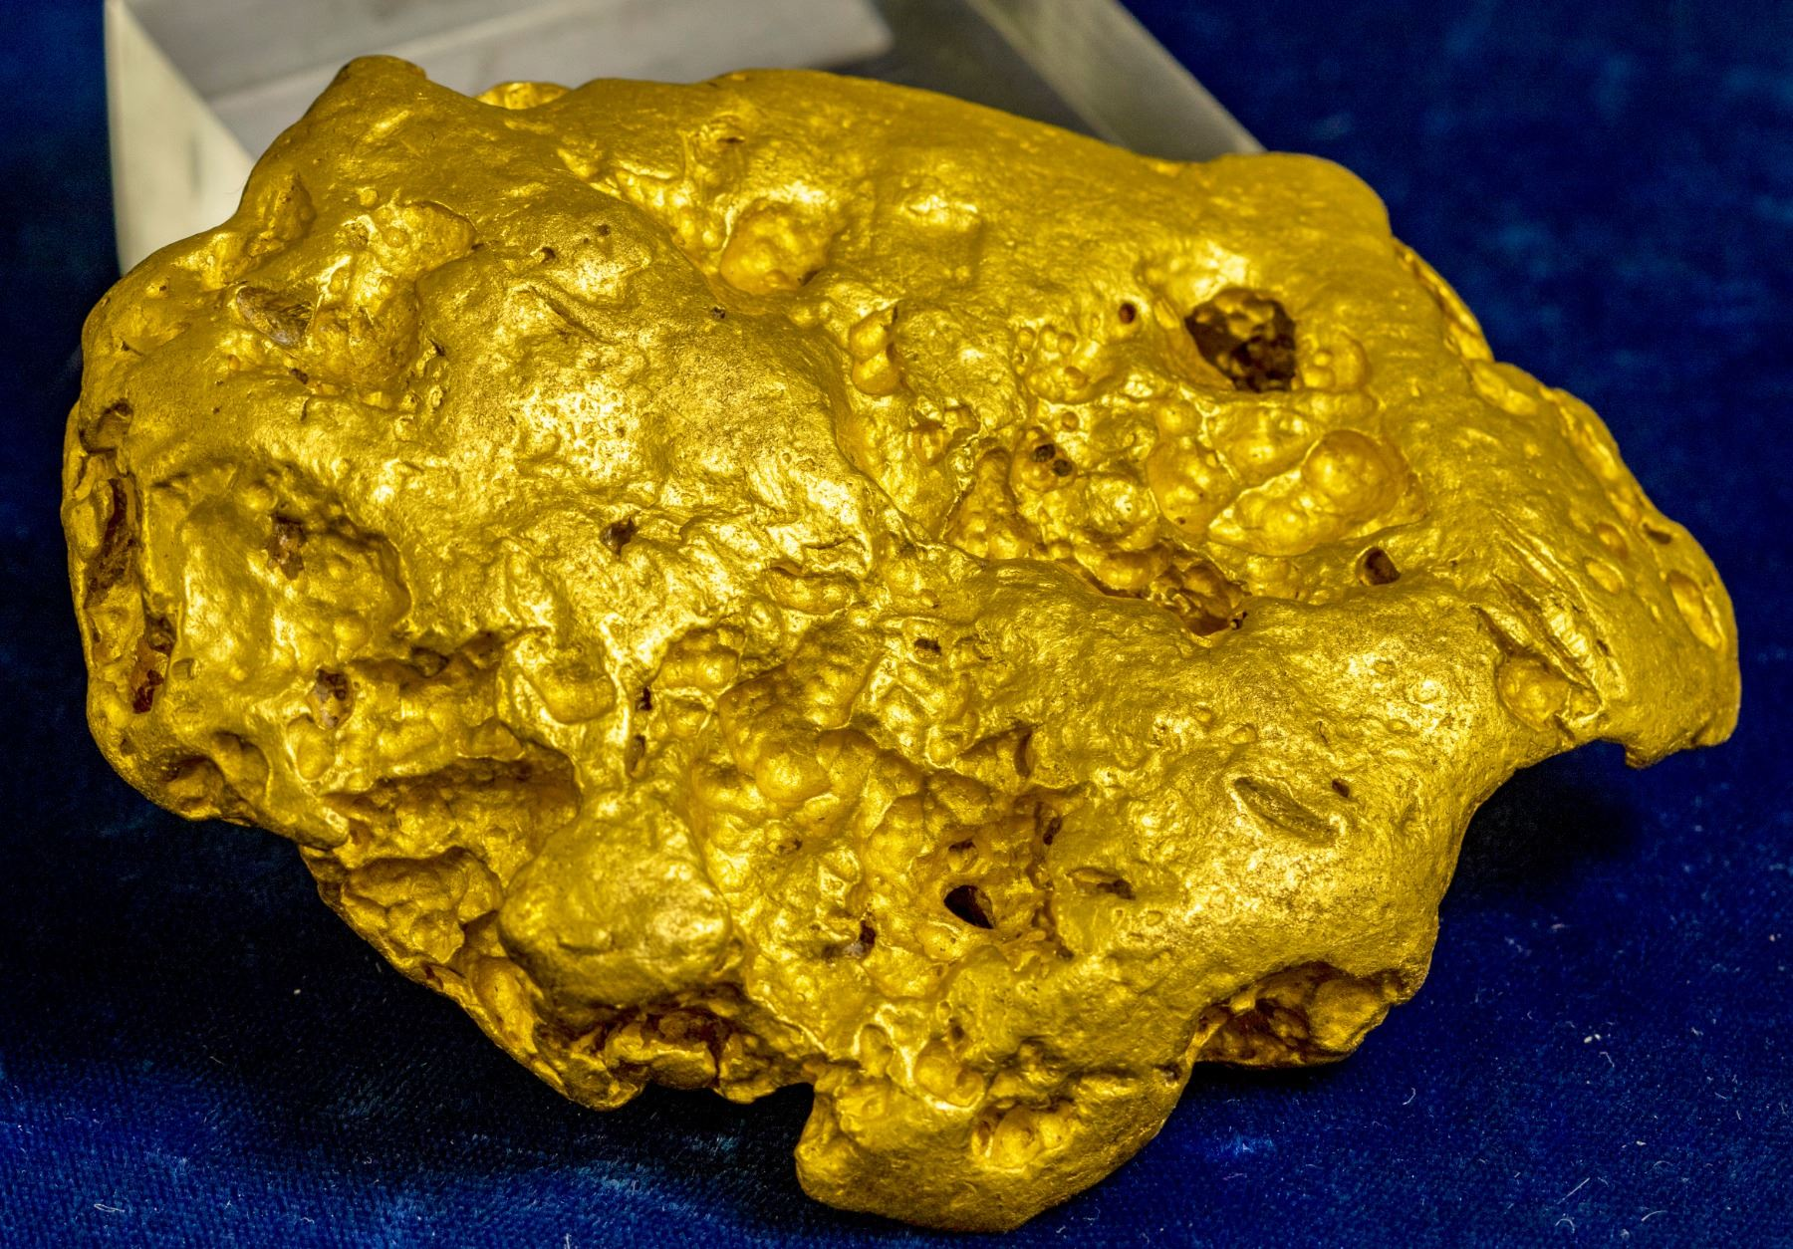
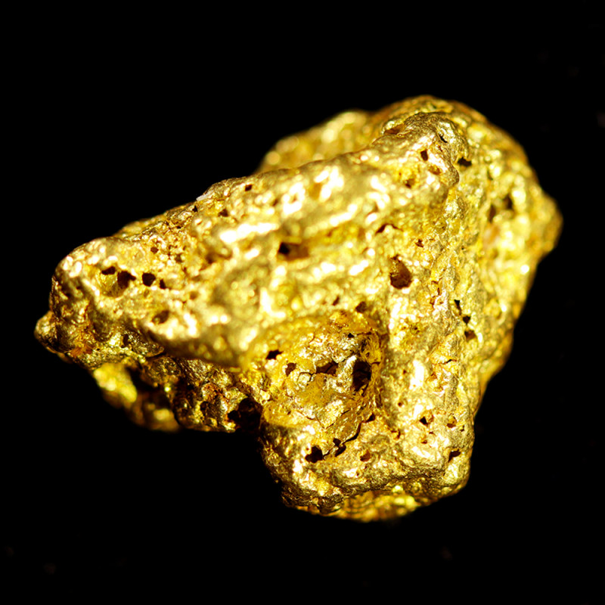
Nuggets of Shannon Information Theory
Christian Schaffner
University of Amsterdam
https://github.com/cschaffner/ITNuggets
MCH 2022, Monday, 25 July 2022

Slide 2
What is communication?
“The fundamental problem of communication is that of reproducing at one point either exactly or approximately a message selected at another point.” - C.E. Shannon, 1948
I want to send 0110
I think Alice sent 0110
Alice
Bob

Slide 3

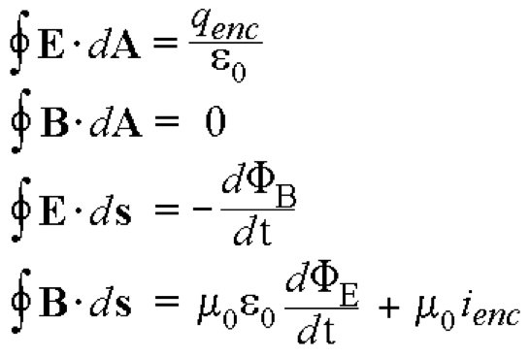
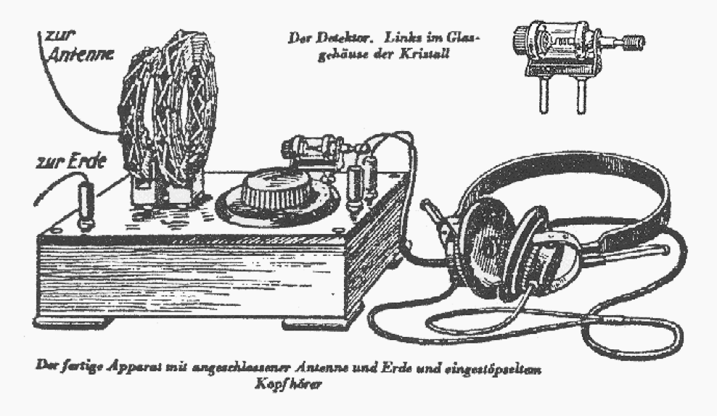
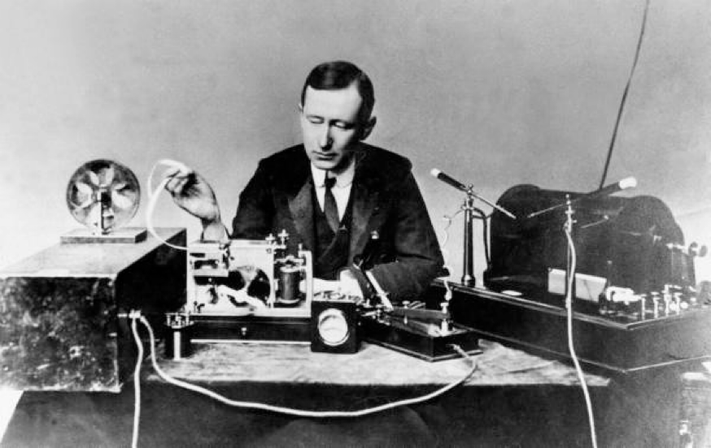
History of (wireless) communication
Smoke signals
1861: Maxwell’s equations
1900: Guglielmo Marconi demonstrates wireless telegraph

Slide 4
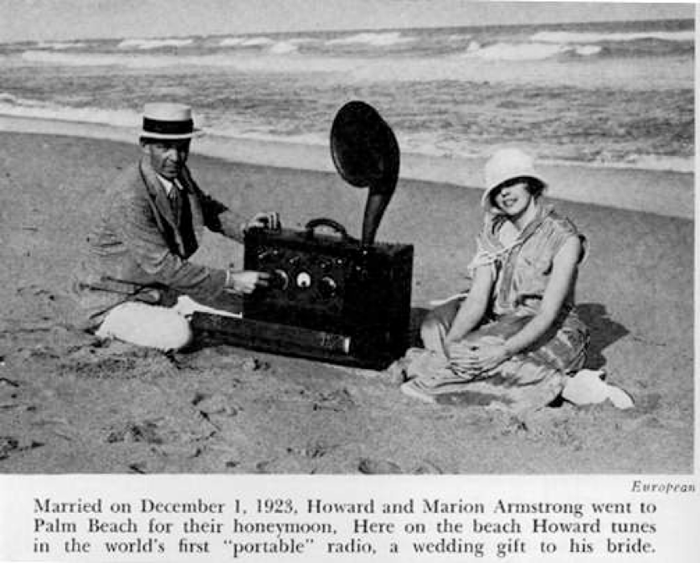
History of (wireless) communication
Smoke signals
1861: Maxwell’s equations
1900: Guglielmo Marconi demonstrates wireless telegraph
1920s: Edwin Howard Armstrong demonstrates FM radio

Slide 5
Big Open Questions
mostly analog
ad-hoc engineering, tailored to each application
is there a general methodology for designing communication systems?
can we communicate reliably in noise?
how fast can we communicate?

Slide 6

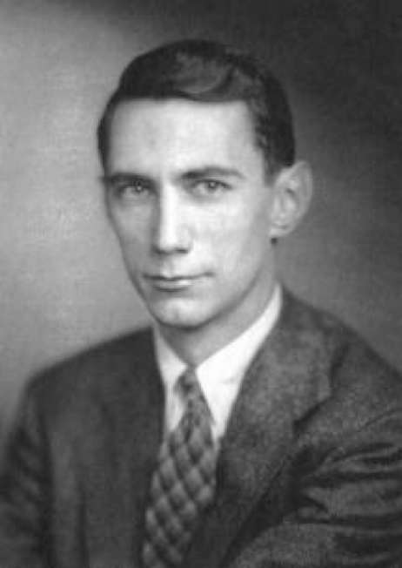
Claude Elwood Shannon (1916-2001)
Father of Information Theory
Graduate of MIT 1940: “An Algebra for Theoretical Genetics’’
1941-1972: Scientist at Bell Labs
1958: Professor at MIT:
juggling, unicycling, chess
ultimate machine
Biographic movie: The Bit Player
When he returned to MIT in 1958, he continued to threaten corridor-walkers on his unicycle, sometimes augmenting the hazard by juggling. No one was ever sure whether these activities were part of some new breakthrough or whether he just found them amusing. He worked, for example, on a motorized pogo-stick, which he claimed would mean he could abandon the unicycle so feared by his colleagues ...

Slide 7
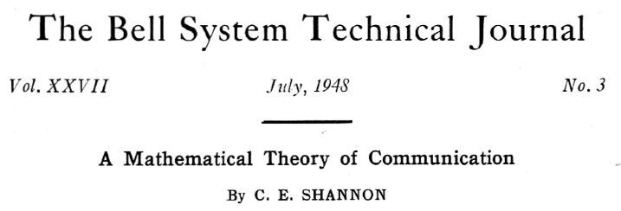
Introduced a new research field: Information Theory
What is information?
What is communication?
How much can we compress information?
How fast can we communicate?

Slide 8




Main Contributions of Information Theory
Data Compression
Data sampled according to a probability distribution
Ultimate data compression limit is the distribution’s entropy H
Error Correction
Channel = conditional probability distribution
Ultimate transmission rate is the channel capacity C
Reliable communication is possible if and only if H < C
Notes:
image: Flaticon.com

Slide 9
Notes:
The chief difficulty Alice found at first was in managing her flamingo: she succeeded in getting its body tucked away, comfortably enough, under her arm, with its legs hanging down, but generally, just as she had got its neck nicely straightened out, and was going to give the hedgehog a blow with its head, it would twist itself round and look up in her face, with such a puzzled expression that she could not help bursting out laughing: and when she had got its head down,

Slide 10
Reactions to the new theory
Engineers in disbelief
Developing practical error-correcting codes took until 2010s to achieve the limits predicted by Shannon in 1948
Applications of Information Theory in
Communication Theory
Computer Science (e.g. cryptography and machine learning)
Physics (thermodynamics)
Philosophy of Science (Occam’s Razor)
Economics (investments)
Biology (genetics, bio-informatics)
…

Slide 11
What will you Learn from this Talk?
Overview
Exponentials & Logarithms
Shannon Entropy
Data Compression
Error Correction

Slide 12
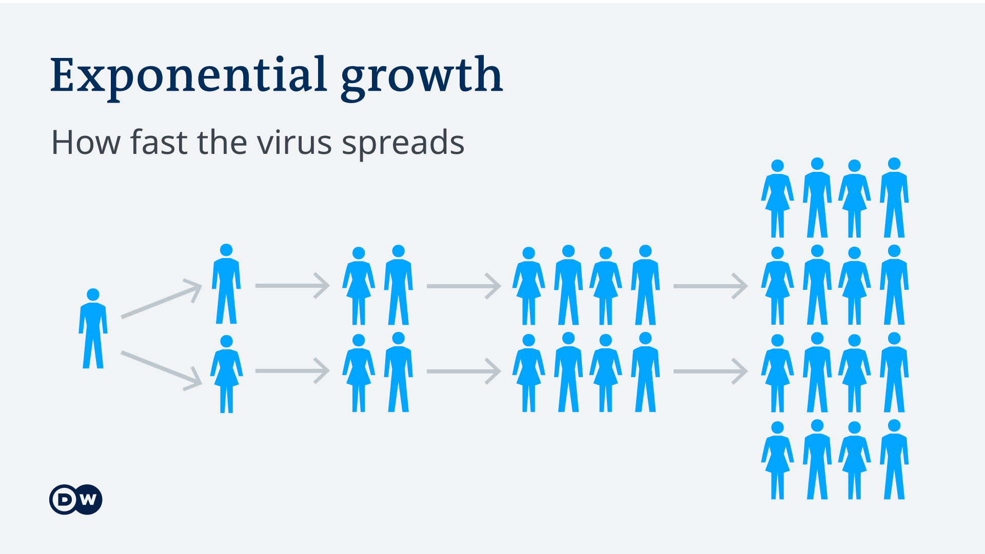



Exponential Functions
Days | # new infections
0 | 1
1 | 2
2 | 4
3 | 8
4 | 16
5 | 32
6 | 64
7 | 128
8 | 256
9 | 512
10 | 1024
11 | 2048
12 | 4096
13 | 8192
… | …
+1
$$×2$$
+1
$$×2$$
+1
$$×2$$

Slide 13
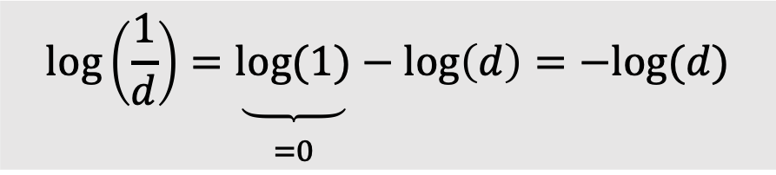
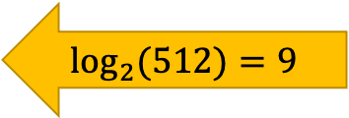
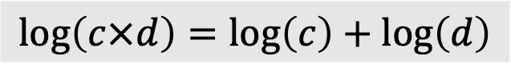
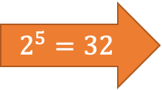

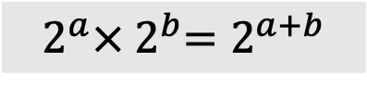
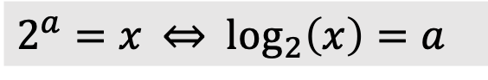
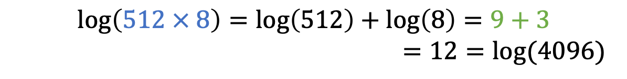
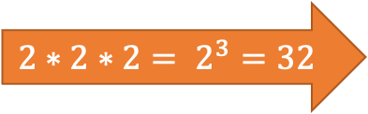
Exponentials & Logarithms
Days | # new infections
0 | 1
1 | 2
2 | 4
3 | 8
4 | 16
5 | 32
6 | 64
7 | 128
8 | 256
9 | 512
10 | 1024
11 | 2048
12 | 4096
13 | 8192
… | …
+1
$$×2$$
$2^{a}=x$ $⇔$ $\log_{2}\left(x\right)=a$
+1
$$×2$$
+1
$$×2$$
$$\log\left(2^{a}\right)=\log_{2}\left(2^{a}\right)=a$$
$${2∗2∗2= 2}^{3}=32$$
Logarithms were invented for easy calculations
They translate multiplications into additions
$$2^{5}=32$$
$$512 × 8=2^{9} × 2^{3}=2^{9+3}=2^{12}=4096$$
$$2^{a}×{ 2}^{b}=2^{a+b}$$
$$\log_{2}{(512)}=9$$
$$\log\left(512 × 8\right)=\log\left(512\right)+\log\left(8\right)=9+3$$
$=12=log⁡(4096)$
$$\log\left(c×d\right)=\log\left(c\right)+\log\left(d\right)$$
$$\log\left(\frac{1}{d}\right)=\underset{\begin{aligned} \\ =0\end{aligned}}{\underbrace{log⁡(1)}}−\log\left(d\right)=−log⁡(d)$$

Slide 14
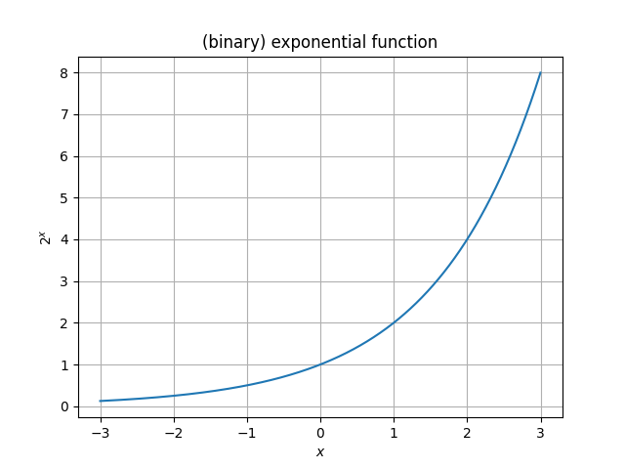
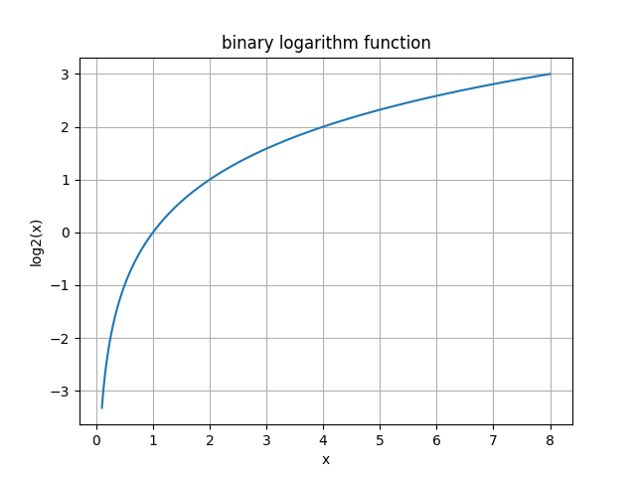
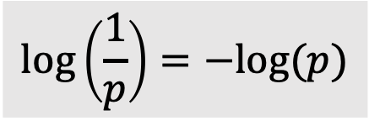
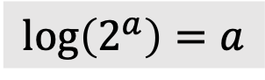
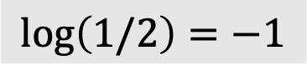


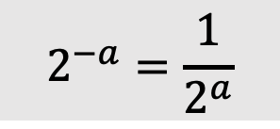
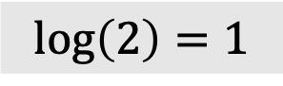

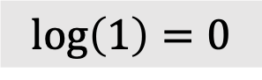
Exponentials & Logarithms
$$\log\left(2^{a}\right)=a$$
$$2^{0}=1$$
$$\log\left(1\right)=0$$
$$\log\left(\frac{1}{p}\right)=−log⁡(p)$$
$$2^{−a}=\frac{1}{2^{a}}$$
$$2^{1}=2$$
$$\log\left(2\right)=1$$
$$2^{−1}=1/2$$
$$\log\left(1/2\right)=−1$$

Slide 15
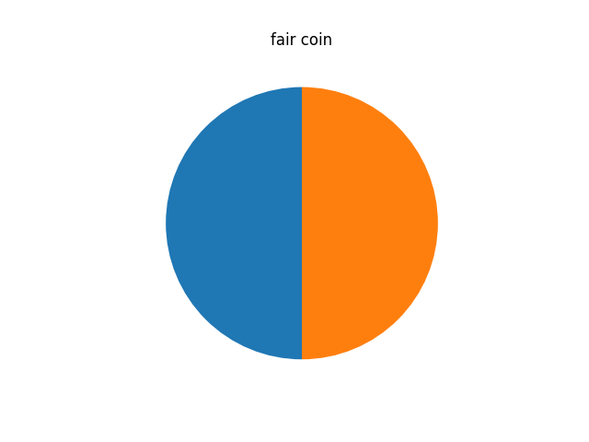
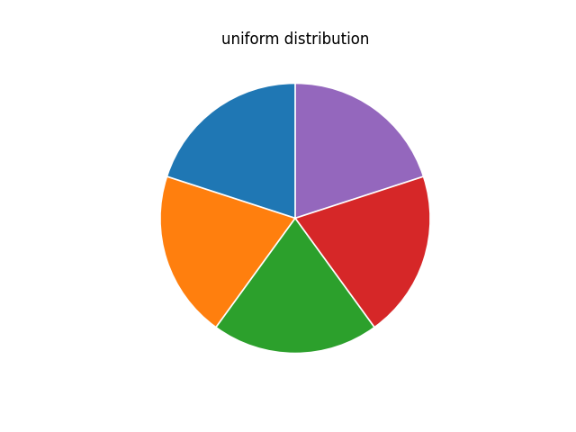
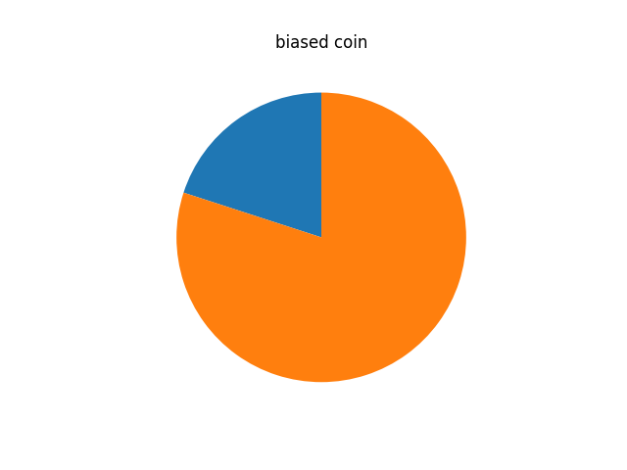
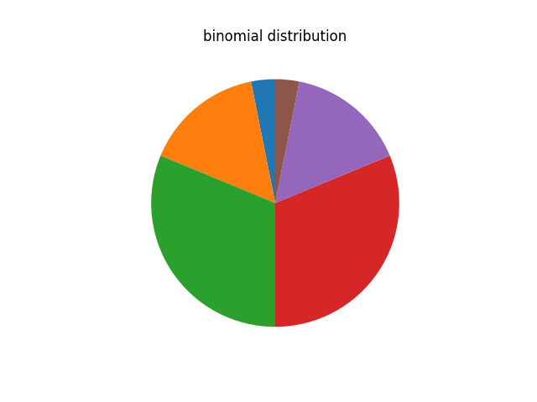
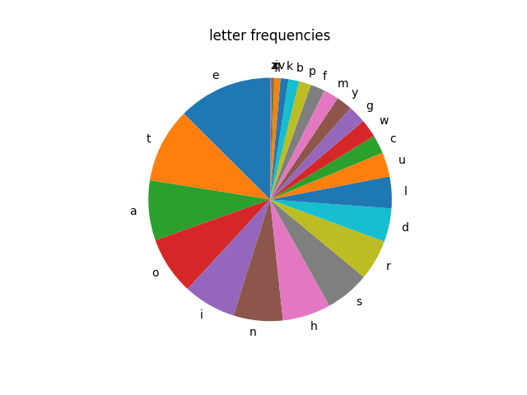
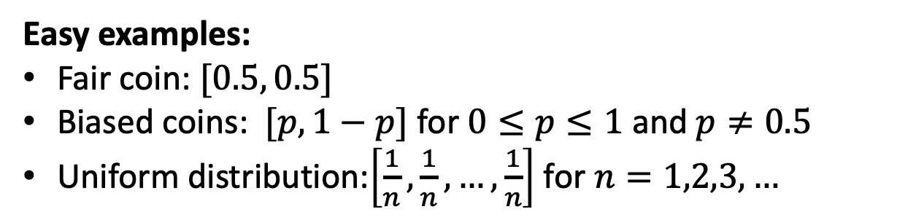
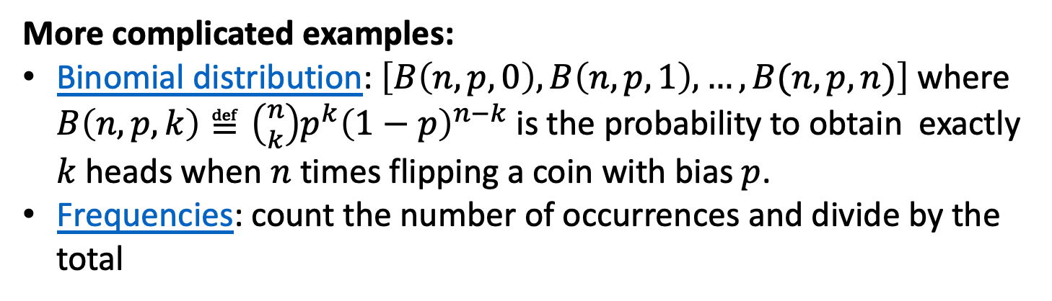
(Discrete) Probability Distributions
Definition: A list of non-negative numbers that sum to 1.
Easy examples:
Fair coin: $[0.5, 0.5]$
Biased coins: $[p, 1−p]$ for $0≤p≤1$ and $p≠0.5$
Uniform distribution:$\left[\frac{1}{n},\frac{1}{n}, …,\frac{1}{n}\right]$ for $n=1,2,3,…$
More complicated examples:
Binomial distribution: $\left[B\left(n,p,0\right),B\left(n,p,1\right), …, B(n,p,n)\right]$ where $B\left(n,p,k\right)≝\left({n \atop k}\right)p^{k}{\left(1−p\right)}^{n−k}$ is the probability to obtain exactly $k$ heads when $n$ times flipping a coin with bias $p$.
Frequencies: count the number of occurrences and divide by the total

Slide 16
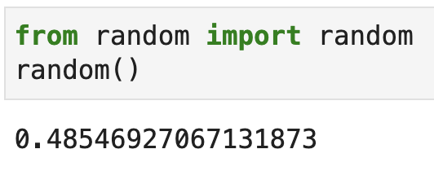
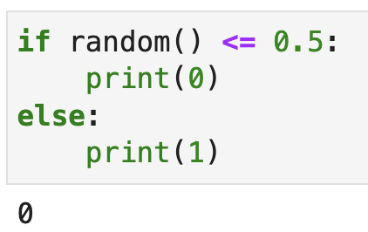
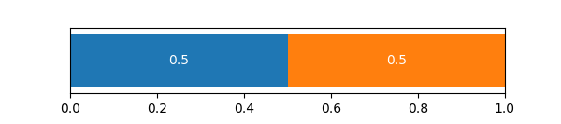


Sampling from Probability Distributions

Slide 17
Sampling from Probability Distributions

Slide 18
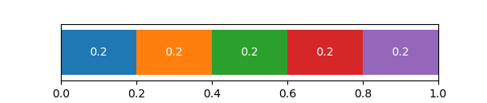
Sampling from Probability Distributions

Slide 19
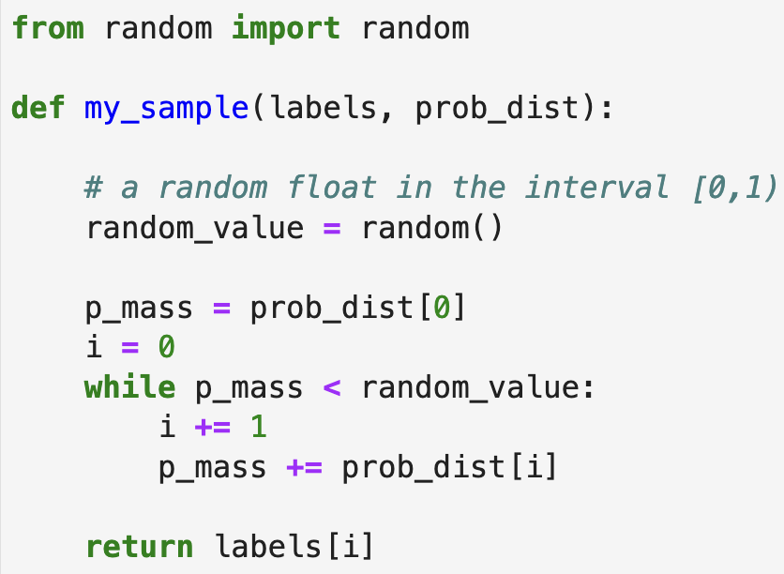
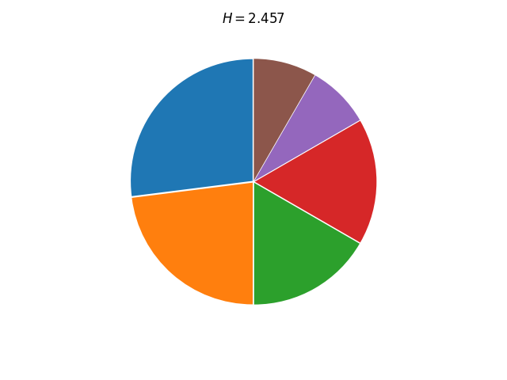
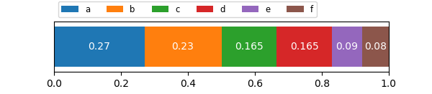
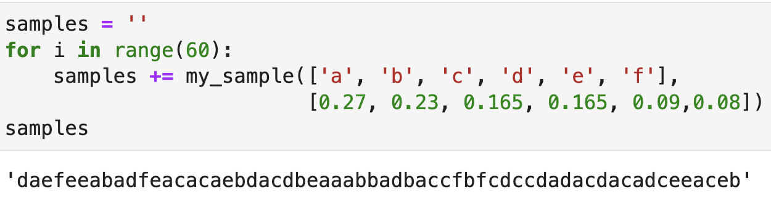
Sampling from Probability Distributions
d a e f e e a b a d …

Slide 20
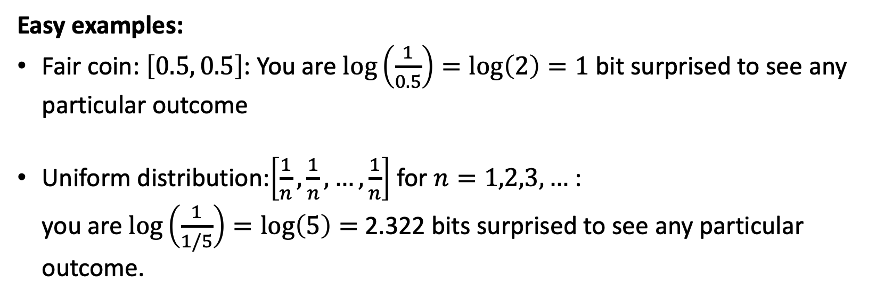
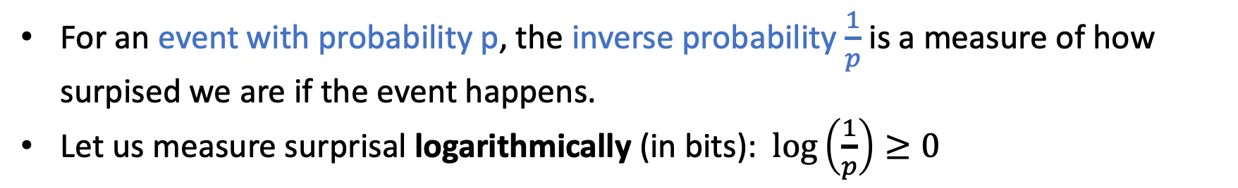
Surprisal 😳 🫢 😯 😲 😱 🤯
For an event with probability p, the inverse probability $\frac{1}{p}$ is a measure of how surpised we are if the event happens.
Let us measure surprisal logarithmically (in bits): $\log\left(\frac{1}{p}\right)≥0$
Easy examples:
Fair coin: $\left[0.5, 0.5\right]$: You are $log\left(\frac{1}{0.5}\right)=log\left(2\right)=1$ bit surprised to see any particular outcome
Uniform distribution:$\left[\frac{1}{n},\frac{1}{n}, …,\frac{1}{n}\right]$ for $n=1,2,3,…$ : you are $\log\left(\frac{1}{1/5}\right)=\log\left(5\right)=$ 2.322 bits surprised to see any particular outcome.

Slide 21
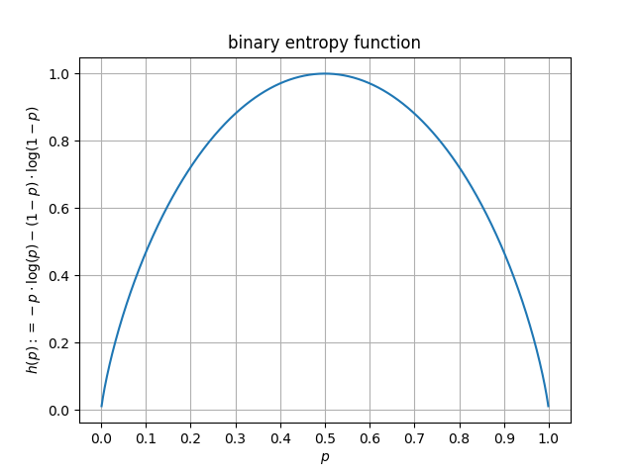
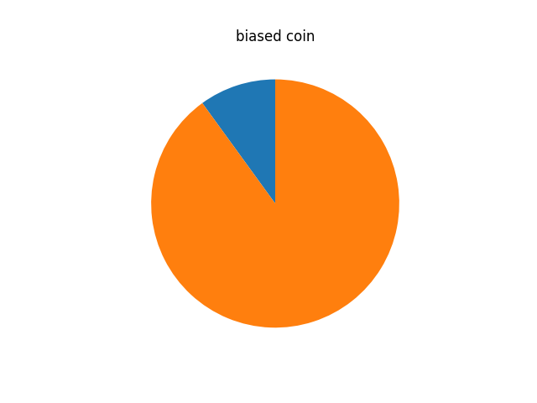
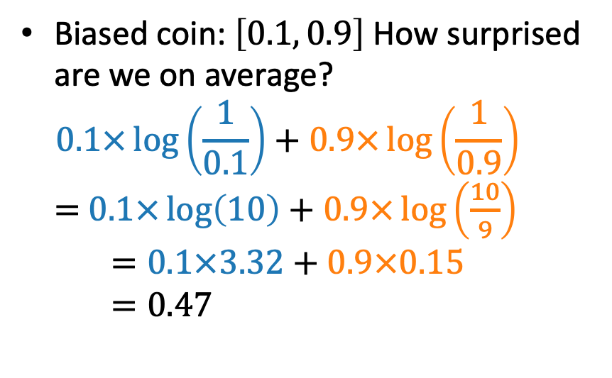
Average Surprisal
For an event with probability p, the inverse probability $\frac{1}{p}$ is a measure of how surpised we are if the event happens.
Let us measure surprisal logarithmically (in bits): $\log\left(\frac{1}{p}\right)≥0$
Biased coin: $\left[0.1, 0.9\right]$ How surprised are we on average? $0.1×\log\left(\frac{1}{0.1}\right)+0.9×\log\left(\frac{1}{0.9}\right)$ $=$ $0.1×\log\left(10\right)+0.9×\log\left(\frac{10}{9}\right)$ $=0.1×3.32+0.9×0.15$ $=0.47$

Slide 22
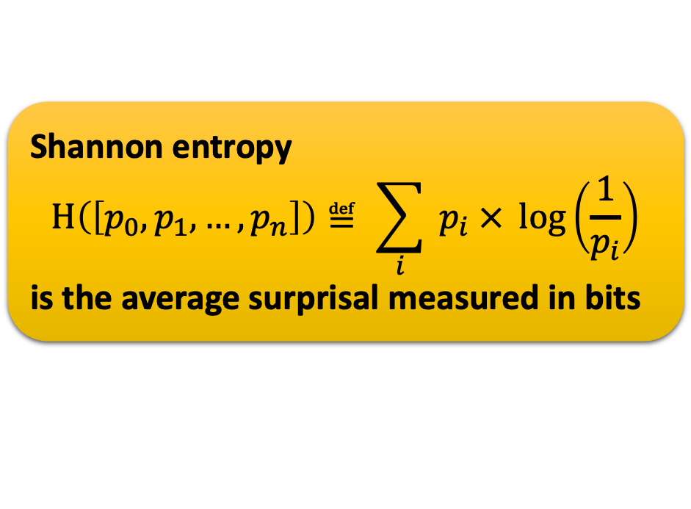
Average Surprisal = Shannon Entropy
For an event with probability p, the inverse probability $\frac{1}{p}$ is a measure of how surpised we are if the event happens.
Let us measure surprisal logarithmically (in bits): $\log\left(\frac{1}{p}\right)≥0$
Shannon entropy $$H\left(\left[p_{0}, p_{1}, …, p_{n}\right]\right)≝ \sum_{i}{{ p}_{i} × \log\left(\frac{1}{p_{i}}\right)}$$ is the average surprisal measured in bits

Slide 23
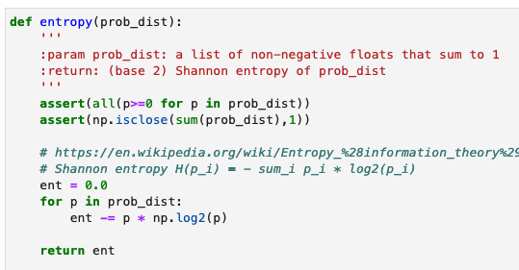
Average Surprisal = Shannon Entropy
For an event with probability p, the inverse probability $\frac{1}{p}$ is a measure of how surpised we are if the event happens.
Let us measure surprisal logarithmically (in bits): $\log\left(\frac{1}{p}\right)≥0$
Shannon entropy $$H\left(\left[p_{0}, p_{1}, …, p_{n}\right]\right)≝ \sum_{i}{{ p}_{i} × \log\left(\frac{1}{p_{i}}\right)}$$ is the average surprisal measured in bits

Slide 24
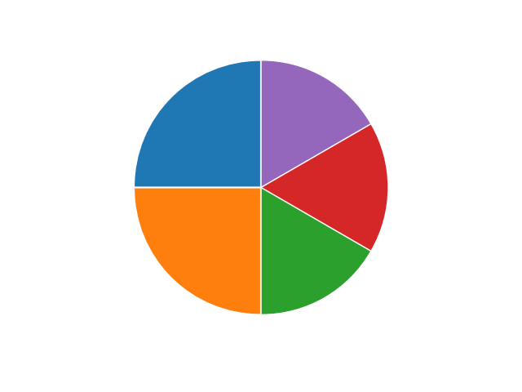
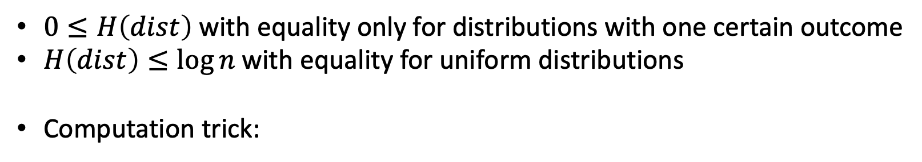


Properties of Shannon Entropy
Shannon entropy $$H\left(\left[p_{0}, p_{1}, …, p_{n}\right]\right)≝ \sum_{i}{{ p}_{i} × \log\left(\frac{1}{p_{i}}\right)}$$ is the average surprisal measured in bits
$0≤H\left(dist\right)$ with equality only for distributions with one certain outcome
$H\left(dist\right)≤\log{n}$ with equality for uniform distributions
Computation trick:
symbol | probability
a | 0.25
b | 0.25
c | 0.166
d | 0.166
e | 0.166
0.5
0.5
$$H=1+0.5 × 1+0.5 ×\log{(3)}$$
0.5
0.5
1/3
1/3
1/3

Slide 25







Order these in terms of Entropy
Shannon entropy $$H\left(\left[p_{0}, p_{1}, …, p_{n}\right]\right)≝ \sum_{i}{{ p}_{i} × \log\left(\frac{1}{p_{i}}\right)}$$ is the average surprisal measured in bits
$0≤H\left(dist\right)$ with equality only for distributions with one certain outcome
$H\left(dist\right)≤\log{n}$ with equality for uniform distributions
$$H=1+0.5 × 1+0.5 ×\log{(3)}$$
$$H=log\left(5\right)=2.322$$
$$H=log\left(2\right)=1$$
$$H=log\left(8\right)=3$$

Slide 26






Order these in terms of Entropy
Shannon entropy $$H\left(\left[p_{0}, p_{1}, …, p_{n}\right]\right)≝ \sum_{i}{{ p}_{i} × \log\left(\frac{1}{p_{i}}\right)}$$ is the average surprisal measured in bits
$0≤H\left(dist\right)$ with equality only for distributions with one certain outcome
$H\left(dist\right)≤\log{n}$ with equality for uniform distributions
$$H=1+0.5 × 1+0.5 ×\log{(3)}$$
$$H=log\left(6\right)=2.585$$
$$H=1.482$$
$$H=2.457$$

Slide 27
What will you Learn from this Talk?
Logarithms
Shannon Entropy
Data Compression
Error Correction

Slide 28


How much information?
01010001…
a e f t t s r l o p q z d

Slide 29


How to measure information content?
…
0 1 0 1 0 0 0 1 …
d a e f e e a b a d …

Slide 30



Measuring Information Content
daefeeabad…
01010001…
daefeeabad…
data
data
L bits
How much “information” is contained in the data?
compress it into minimal number of L bits (per source symbol)
so that data can still be recovered perfectly
⇒ average information content is L bits per symbol
Information content L ≈ H( data distribution )

Slide 31

Part 1: lower bound on L
Information content L ≧ H( data distribution )
We want to prove that at least H(dist) bits per source symbol are required no matter what compression scheme is used.
qed

Slide 32
Part 2: upper bound on L
Information content L ≦ H( data distribution )
We give a compression method that uses H(dist) bits per symbol.
Huffman coding (by example):
Combine the two nodes with smallest probability into new one with combined weight
Codeword is given by route from root to leaf.
symbol | Code word | probability
a | 10 | 0.25
b | 00 | 0.25
c | 01 | 0.2
d | 110 | 0.15
e | 111 | 0.15
0
0
0.45
0
1
1
0
0.55
1
0.3
1
1

Slide 33
Huffman code for letter frequency
Book by David MacKay

Slide 34

Proof: L <= H( data distribution )
Shannon: L ≈ H( data distribution )
We give a compression method that uses H(dist) bits per symbol.
Experiment: Alice’s adventures in Wonderland
# characters | 100000
# bits in ASCII ( times 8) | 8*100000 = 800000
# bits in Huffman coding | 407804
Shannon entropy: # bits per character | 404175
Shannon entropy $×$ # characters | 515778
#bits when zipped | 369248

Slide 35

Proof: L <= H( data distribution )
Shannon: L ≈ H( data distribution )
We give a compression method that uses H(dist) bits per symbol.
Experiments: Alice’s adventures in Wonderland & random samples
# characters | 123606
# bits in ASCII ( times 8) | 8*123606 = 988848
# bits in Huffman coding | 519188
Shannon entropy: # bits per character | 4,173
Shannon entropy $×$ # characters | 515778
#bits when zipped | 369248

Slide 36
What will you Learn from this Talk?
Logarithms
Shannon Entropy
Data Compression
Error Correction

Slide 37
Joint Probability Distributions
Distribution: A list of non-negative numbers that sum to 1. Joint distribution: arranged along two dimensions
Examples:
Fully correlated
Fully anti-correlated
Uniformly random
 | X=0 | X=1
Y=0 | 0.5 | 0.0 | 0.5
Y=1 | 0.0 | 0.5 | 0.5
 | 0.5 | 0.5
 | X=0 | X=1
Y=0 | 0.0 | 0.5 | 0.5
Y=1 | 0.5 | 0.0 | 0.5
 | 0.5 | 0.5
 | X=0 | X=1
Y=0 | 0.25 | 0.25 | 0.5
Y=1 | 0.25 | 0.25 | 0.5
 | 0.5 | 0.5

Slide 38
Joint Probability Distributions
Distribution: A list of non-negative numbers that sum to 1. Joint distribution: arranged along two dimensions
Bigger Example

Slide 39





Joint Entropy and Mutual Information
$$H(X)$$
$$H(Y)$$
The mutual information
$$I\left(X:Y\right)≝ H\left(XY\right)−H\left(X\right)−H\left(Y\right)$$
is a measure of correlation between X and Y
$$I(X:Y)$$
Extreme cases:
$I\left(X:Y\right)=0$ iff X and Y are independent
$I\left(X:Y\right)$ is maximal if X and Y are identical
Interactive toy: https://content.datanose.nl/interactive-graphs/entropy-diagrams.htm

Slide 40







Noisy Channel
noisy channel
$$P_{Y|X}$$
X
Y
Described by a conditional probability distribution $P_{Y|X}$
For every input value x, $P_{Y|X=x}$ is a distribution over output values $y$
Example: binary symmetric channel (BSC)
input X
0
1
output Y
0
1
Input bit is flipped with probability $ε=0.1$
$$P_{Y|X=0}: [0.9 , 0.1]$$
$$P_{Y|X=1}: [0.1 ,0.9]$$
$$1−ε$$
$$ε$$
$$ε$$
$$1−ε$$

Slide 41
Surviving a Binary Symmetric Channel (BSC)
encoder
BSC(0.1)
decoder
X
Y
message
message
0110…
Example: repetition code
X = 000 111 111 000 …
Y = 100 111 101 000 … can be decoded by “majority vote”
Rate: 1/3 (not so good)
Probability of success: 0.97 per bit
Example: no encoding
X = 0 1 1 0 …
Y = 0 1 1 1 …
Rate: 1 (optimal)
Probability of success: 0.9 per bit
Figures of merit (want to maximize):
1. Code rate: transmitted message bits per channel use
2. Probability of correctly decoding the message

Slide 42








Hamming code
encoder
BSC(0.1)
decoder
X
Y
message
message
0110…
Example: Hamming code
$X = m_{1}m_{2}m_{3}m_{4}t_{5}t_{6}t_{7}$
X = 0110 101
Y = 0111 101
Rate: 4/7 Probability of success: 94% (per bit)
$$m_{2}$$
1
$$t_{5}$$
$$t_{6}$$
1
0
$$m_{3}$$
0
$$m_{1}$$
$$m_{4}$$
0
1
$$t_{7}$$
1

Slide 43


Surviving Noisy Channels
encoder
BSC(0.1)
decoder
X
Y
message
message
0110…
$$C≝\max_{P_{X}}{I(X:Y)}$$
BSC(0.1) channel: $C=1−h\left(0.1\right)=0.53$
Every channel has a capacity C. There exist error-correcting codes to cope with the noisy channel at any rate R<C.
Shannon argues that randomly chosen codes do the job. Unfortunately, decoding random codes is inefficient…

Slide 44
What have you learned from this talk?
Overview
Exponentials & Logarithms
Shannon Entropy
Data Compression
Error Correction

Slide 45
Main Contributions of Information Theory
Data Compression
Data sampled according to a probability distribution
Ultimate data compression limit is the distribution’s entropy H
Error Correction
Channel = conditional probability distribution
Ultimate transmission rate is the channel capacity C
Reliable communication is possible if and only if H < C

Slide 46
Thank you for your attention!
https://github.com/cschaffner/ITNuggets
c.schaffner@uva.nl

